Slide 1

Biostatistics DAY 4: Big Data & Dimension Reduction
Justin Whalley

Slide 2
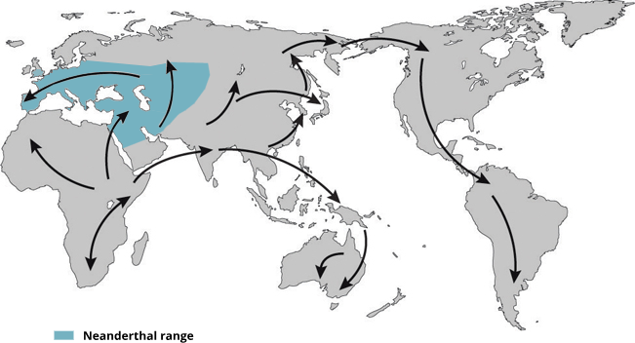
Modern non-African humans contain Neanderthal DNA fragments in their genomes
Interbreeding
~50,000 years ago
Neanderthal
African
Non-African
1.5~4%
Neanderthal
ancestry
Slide from Shiyao Ke
Map adapted from Mafessoni, F. (2019). Nat. Ecol. Evol. 3:14–15.
Notes:
Map adapted from Mafessoni, F. (2019). Encounters with archaic hominins. Nature Ecology & Evolution. 3, 14–15. (https://www.nature.com/articles/s41559-018-0729-6)

Slide 3
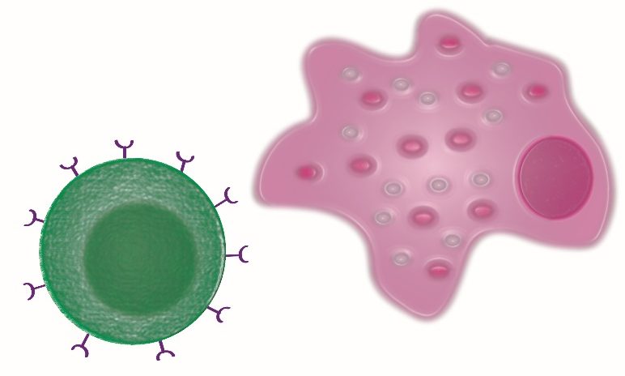

iPSC Derived Macrophages as a Model
Many immune cell types are implicated in disease
Unsure which is the most relevant
Strong evidence for monocytes/macrophages and T cells
Primary immune cells difficult to culture and edit
Limon-Camacho et al. J Rheumatol 2012
Wright et al. Ann Rheum Dis 2009
Zambrano-Zaragoza et al. Int J Inflam.2013
Notes:
Stem cells could be differentiated into other cell types down the line
Monocytes are the precursors for macrophages and dendritic cells, which are all involved in antigen presentation. Studies have found that monocytes in arthritis patients exhibit an upregulation of genes involved in essential inflammation pathways (101–103). One study used label-free quantitative expression profiling to examine protein expression (103). They noted upregulation in AS monocytes in proteins involved in leukocyte recruitment, and important signalling pathways such as, VEGF, JAK/STAT, and toll-like receptor (TLR). Moreover, there was shown to be an upregulation of genes in the ubiquitin proteasome pathway (UPP) in AS monocytes (103). This pathway is involved in the formation of peptides to be presented by HLA ClassI proteins, like HLA-B27.
One theory of AS pathogenesis, known as the arthritogenic
peptide hypothesis, relies on the involvement of CD8þT cells
[99, 100]. This hypothesis suggests that the self-peptides displayed
by HLA-B27 bear a resemblance to peptides produced by
foreign microbes and become the target of autoreactive CD8þT
cells. These cells then initiate an immune response and inflammation
ensues.
Moreover, it was found that CD4þT cells express
KIR3DL2, which is a receptor that recognizes homodimers
of HLA-B27 but does not recognize heterodimers of HLA-B27
The binding of KIR3DL2 to HLA-B27 homodimers could
trigger an immune response and lead to inflammation, and it is
also suggested that binding triggers Th17 responses
Monocytes in spondyloarthritis
patients exhibit an upregulation of genes involved in
essential inflammation pathways.

Slide 5
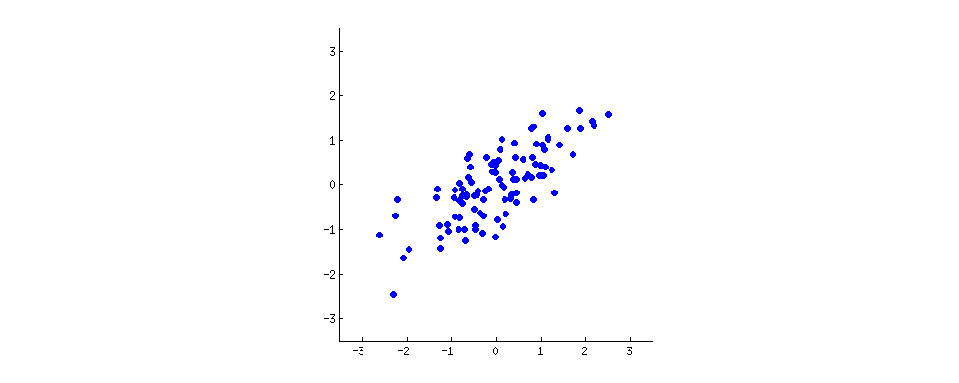
PCA: defining components
https://stats.stackexchange.com/questions/2691/making-sense-of-principal-component-analysis-eigenvectors-eigenvalues
Notes:
Looking at two characteristics of a our dataset (x and y). Want to reduce it from 2D to 1D.
A new property can be constructed by drawing a line through the centre of this cloud and projecting all points onto this line. This new property will be given by a linear combination w1x+w2y, where each line corresponds to some particular values of w1 and w2.

Slide 6
PCA: defining components
https://stats.stackexchange.com/questions/2691/making-sense-of-principal-component-analysis-eigenvectors-eigenvalues
Notes:
PCA will find the "best" line according to two different criteria of what is the "best". First, the variation of values along this line should be maximal. Pay attention to how the "spread" (we call it "variance") of the red dots changes while the line rotates; can you see when it reaches maximum? Second, if we reconstruct the original two characteristics (position of a blue dot) from the new one (position of a red dot), the reconstruction error will be given by the length of the connecting red line. Observe how the length of these red lines changes while the line rotates; can you see when the total length reaches minimum?

Slide 7
PCA on highly correlated data
Notes:
When we have a high correlation, reducing the dimensions makes sense (in this case the PCA component one explains a high percentage of variance of the dataset).

Slide 8
PCA on uncorrelated data
Notes:
However when we have low level of correlation, we are less successful in reducing the dimensions, in this case both components tend to explain the same amount of variance of the dataset.
We rarely would use PCA on a two dimensional dataset, lets look instead a gene expression experiment.

Slide 9

WHOLE GENOME gene expression
donor
genes
Non-treated, ‘naive’,
monocytes
Notes:
In this dataset we have:
228 donors, ~15000 gene expression values

Slide 10
WHOLE GENOME gene expression
donor
genes
Naive
IFNγ treated
monocytes
Notes:
Gene expression for the monocytes treated by inteferon-gamma – proteins that help regulated the immune system.

Slide 11
WHOLE GENOME gene expression
donor
genes
Naive
IFNγ
Lipopolysaccharide (LPS) treated
monocytes (2 hour wait)
Notes:
Major component of the outer wall of gram negative bacteria, which our body registers as a toxin and elicits a strong immune response.

Slide 12
donor
WHOLE GENOME gene expression
genes
Naive
IFNγ
LPS 2h
Lipopolysaccharides (LPS) treated
monocytes (24 hour wait)
12
Notes:
Also gene expression after 1 day of being treated.

Slide 13
WHOLE GENOME gene expression
donor
genes
Fairfax et al. Innate immune activity conditions the effect of regulatory variants upon monocyte
gene expression. Science, 2014.
Naive
IFNγ
Treatment
LPS 2h
LPS 24h
Notes:
So we have a dataset for 912 samples, gene expression data for ~15,000 genes.

Slide 14
whole genome GENE expression
Notes:
No doubt there is high redundancy amongst the samples, so reducing them from ~15000 to a smaller number could be really helpful into interpreting the dataset (in this case for projecting the gene expression and genes into one value for each sample for each principal component).

Slide 16
Multiple testing – Bonferroni-holm method
Suppose you have m p-values, sorted into order lowest-to-highest P₁ , … , P_{m}, and their corresponding hypotheses H₁ , … , H_{m} .
Choose a significance level α (e.g. 0.05).
Is P₁ < α / m ? If so, reject H₁ and continue to the next step, otherwise EXIT.
Is P₂ < α / m-1 ? If so, reject H₂ and continue to the next step, otherwise EXIT.
…
And so on: for each P value, test whether P_{k} < α / m + 1 − k

Slide 17
Multiple testing – Benjamini-Hochberg method
For given α let k find the largest k such that P_{(k)} ≤ (k/m) α
and reject null hypothesis H_{i} for i=1,..,k

